Slide 1
Vaping, Alcohol & Marijuana: What’s the Big Deal?
Mark Thompson, PhD
Educational Program Consultant, KSDE

Slide 2
Laying the Foundation
Using Menti: 92106604
Share what you believe are the most used “drugs” (we’re going to exclude caffeine).
Share what you believe are the most “dangerous” drugs.
Share what you believe are the most addictive drugs.
Notes:
Fact Sheet

Slide 3
More Questions
Using Menti:
What is the most dangerous animal?
What animal kills the most humans?
We’ll file these away for future discussion.
Notes:
Fact Sheet

Slide 4
Most Used Drugs*
Alcohol
Tobacco
Marijuana
Cocaine
Heroin
Hallucinogens
Methamphetamine
*Discover Recovery
Notes:
Fact Sheet

Slide 5
Others
Tranquilizers (Xanax, Valium, Klonopin)
Stimulants (Adderall, Ritalin, Amphetamines)
Ecstasy
Inhalants
Sedatives (Barbiturates, Quaaludes)
Notes:
Fact Sheet

Slide 6
What Makes a Drug Dangerous
Potential for Abuse
Potential for Addiction
Psychological
Physiological
Potency of Drug
Side Effects
Notes:
Fact Sheet

Slide 7
Most Dangerous Drugs*
Nicotine (480,000 deaths in US/year)
Alcohol (88,000 deaths/year)
Fentanyl (18,335 deaths)
Heroin (16,000 deaths)
Cocaine (11,316 deaths)
*Infinite Recovery
Notes:
Fact Sheet

Slide 8
Most Addictive Drugs*
Cocaine
Heroin
Alcohol
Nicotine
Methamphetamine
*National Survey on Drug Use & Health
Notes:
Fact Sheet

Slide 9
Animal Questions
10. Lions = 200/year
9. Hippos = 500/year
8. Elephants = 600/year
7. Crocodiles = 1,000/year
6. Scorpions = 3,300/year
5. Assassin Bugs = 10,000/year
4. Dogs = 59,000/year
3. Snakes = 138,000/year
2. Humans = 400,000/year
1. Mosquitoes = 725,000/year

Slide 10
More On the Dangers of Animals
A CDC report from a few years back found that cows killed about twenty people a year in the mid-2000s. That makes cows about 20 times as lethal as sharks. These deaths aren't due to marauding packs of feral bovines terrorizing suburban neighborhoods, but rather incidents involving working with cattle on farms. As the CDC report notes, "large livestock are powerful, quick, protective of their territory and offspring, and especially unpredictable during breeding and birthing periods." Most people killed by cows are farm workers.
Notes:
Fact Sheet

Slide 11
And, Yet, Still More
Going beyond cattle, dogs about kill 28 people per year, and other miscellaneous mammals, like horses, pigs, deer and the like, kill 52 (excluding deaths due to vehicle collisions with these animals). But the number 1 animal killers on an annual basis are bees, wasps and hornets, responsible for 58 deaths each year -- mostly due to anaphylactic shock after a sting.
So, to put things in perspective, statistically speaking you're 28 times more likely to be killed by a dog than you are by a shark. But this doesn't mean that you should trade in your beagle-basset mix for a great white.
Notes:
Fact Sheet

Slide 12
Thoughts, Observations?
What surprised you?
What didn’t surprise you?
Notes:
Fact Sheet

Slide 13
Our Focus
Alcohol
Marijuana
Tobacco/Nicotine
For each, we will address:
Potential for abuse
Potential for addiction
Potency of drug
Effects/Side Effects
Notes:
Fact Sheet

Slide 14
Alcohol
Potential for Abuse – 69.5% used in last year, 59.1% used in last month (140 million users) – National Institute on Alcohol Abuse & Alcoholism
Potential for Addiction – 1 in 8 adults (12.7%) – JAMA 2017
Potency of Drug – beer → wine → “hard liquor”
Effects/Side Effects – relaxation, sense of euphoria, lowered inhibitions, impulsive behavior, slurred speech, loss of coordination, loss of consciousness
Notes:
Fact Sheet

Slide 15
Tips for Responsible Drinking (Alcohol)
Eat prior to consuming alcohol
Drink plenty of water
Don’t mix alcohol with energy drinks
Avoid salty snacks
Count your drinks
Skip drinking games and shots
Don’t drink and drive
Notes:
Fact Sheet

Slide 16
Marijuana (Active Ingredient – THC)
Potential for Abuse – 18% used in 2019 (48.2 million) – CDC
Potential for Addiction – 3 in 10 users have marijuana use disorder
Risk for disorder is greater for those who begin use before 18. - CDC
Potency of Drug – not a regulated product, so potency varies.
Effects/Side Effects – relaxation, sense of euphoria, heightened sensory perception, laughter, altered perception of time, increased appetite, anxiety, fear, panic, psychosis (hallucinations, delusions), lowered inhibitions, impulsive behavior – National Institute on Drug Abuse
Notes:
Fact Sheet

Slide 17
Forms of Consumption
Smoking
Edibles
Vaping
Notes:
Fact Sheet

Slide 18
Responsible Use?
Notes:
Fact Sheet

Slide 19
Tobacco/Nicotine: A Tale of Two Paths
Tobacco Cigarettes
Potential for Abuse – 13.7% used in 2018, down from 42.6% in 1965 – American Lung Association
Potential for Addiction – 85% of daily smokers are addicted to nicotine, 2/3 of those smoking only 1-4 cigarettes/day are addicted. – US News & World Report
Potency of Drug – typical cigarette contains 10 mg of nicotine, with avg person getting 1-2 mg.
Effects/Side Effects – well-established (not good).
Notes:
Fact Sheet

Slide 20
Tobacco/Nicotine: A Tale of Two Paths
E-Cigarettes
Potential for Abuse – 22% Kansas HS students used in the last month in 2019, up from 10.6% in 2017 – Kansas 2019 Youth Risk Behavior Survey
Potential for Addiction – Between 2017 and 2019, the percentage of Kansas HS students who vaped daily increased 271% – 2019 YRBS
Potency of Drug – one “pod” is comparable to at least 1 pack of cigarettes (amt. of nicotine), study found level of nicotine concentrations in Juul users to be 5.2 times higher than cigarette smokers. – University of California San Francisco
Effects/Side Effects – not well-established, but not good.
Notes:
Fact Sheet

Slide 21
Responsible Use?
Notes:
Fact Sheet

Slide 22
Bringing it Full Circle
Alcohol can’t just be dismissed because it’s so widely used and engrained in our society.
We have to look at “why”, “when”, and “how” people use and abuse alcohol.
Is the right approach to focus on responsible use?
Emphasis should be placed on demonstrating respect for those who choose to not use.
Notes:
Fact Sheet

Slide 23
Bringing it Full Circle
The landscape regarding marijuana/THC is changing.
Medicinal use laws
Recreational use laws
Societal acceptance?
Difficult to predict where we’re heading and the issue is extremely complicated including the forms of consumption & regulating.
Marijuana can’t just be dismissed because it’s so widely used and engrained in our society. “It’s only marijuana.”
Notes:
Fact Sheet

Slide 24
Bringing it Full Circle
Nicotine is often dismissed or diminished compared to its impact, addictive properties, and challenges to quitting.
General public not sympathetic to those who are trying to quit.
Significant stigma attached to use of tobacco cigarettes – vaping, not so much.
Vaping poses a significant danger, especially for youth & young adults.
Faster, stronger developing of addiction.
Notes:
Fact Sheet

Slide 25
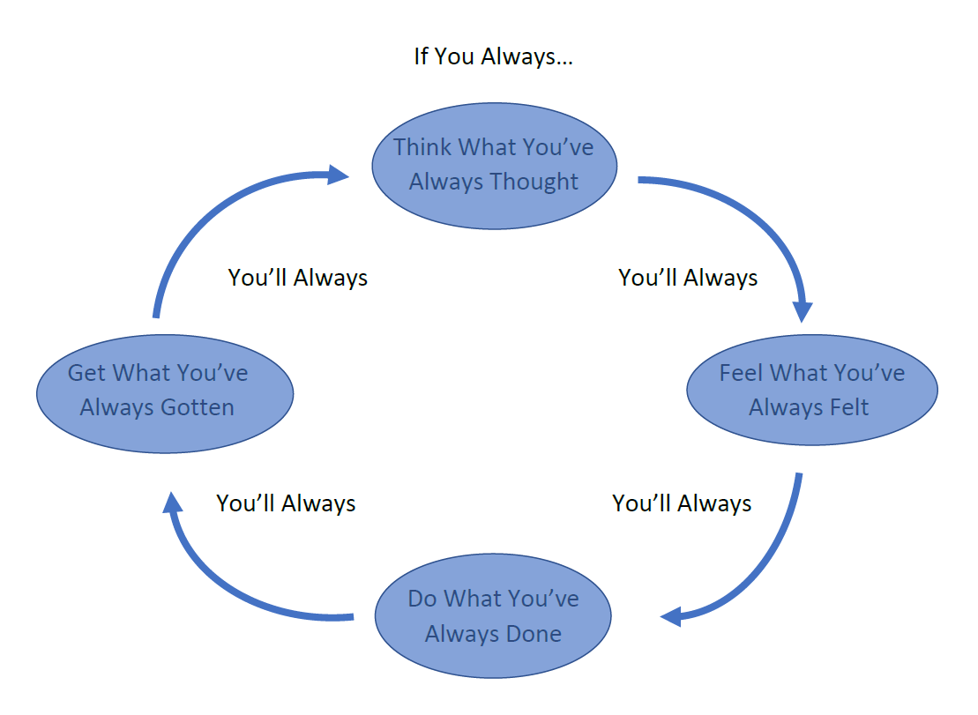
So What Can Be Done?
We begin with the following assumption regarding human behavior:
Notes:
Fact Sheet

Slide 27
What Do We Typically:
Think?
Feel?
Do?
Get?

Slide 28
Change the Cycle
Different thinking
Different feeling
Different actions
Different outcomes

Slide 29
An Example of a Different Approach: Motivational Interviewing
Student behaviors to which Motivational Interviewing can be applied:
Vaping (tobacco, marijuana)
Smoking
Drinking
Marijuana
Self-injurious behaviors
Nutrition
And more!
Think… Any behavior that a student may feel ambivalence towards
Notes:
Fact Sheet

Slide 30
The “Standard” Approach
The school professional is the expert and…
Information/education is sufficient and…
Behavior changes is prescribed (“You need to quit…”) and…
Consequences are enforced.
Result is student:
Agrees but does nothing
Becomes resistant, defiant
Leaves feeling angry, unheard, overwhelmed
Doesn’t return because they haven’t felt heard, feel guilt, shame, embarrassment and have not or cannot follow through.
Notes:
Fact Sheet

Slide 31
Problems With “Standard” Approach
Psychological reactance
It is human nature to actively oppose unwanted authority
Unwelcome advice elicits resistance
If you list all the reasons FOR making a change, all it leaves for the student to share is all the reasons AGAINST what you’ve just said
Knowledge weakly correlated with behavior change
Education is good for prevention, but does little to motivate change when behavior is already in place
Notes:
Fact Sheet

Slide 32
Problems With “Standard” Approach
Student and teacher/staff member leaves frustrated
We are usually convinced more easily by reasons we have found ourselves than by those which have occurred to others.
It is much more powerful to hear our own voices articulate reasons for change versus hearing someone else tell us why we should change.
Notes:
Fact Sheet

Slide 33
Reasons People Change
Disadvantages of status quo.
They recognize the problems with the current situation.
Advantages of change.
They see a reason for change AND the benefits of change outweigh the barriers.
They believe they can.
Eliciting and highlighting these are your goals for the conversation.
Notes:
Fact Sheet

Slide 34
Negotiating Behavior Change
Goal is to elicit motivation from the student not impose it
BEHAVIOR CHANGE SHOULD BE: NEGOTIATED NOT PRESCRIBED
To do this, the goals are:
To help student begin to recognize problem with the current situation
To help student begin to see reasons for change
To believe change is possible
Student leaves feeling empowered, not guilty or shamed
Notes:
Fact Sheet

Slide 35
Motivational Interviewing Principles
Motivational Interviewing (MI) is a method for helping individuals increase their motivation to change
Can be done within a short period of time (< 30 minutes)
Collaboration vs authoritarian, one-upping
Evocation vs imparting or inserting knowledge
Autonomy-supporting vs controlling
Empathy vs dismissive, disrespectful
Notes:
Fact Sheet

Slide 36
Putting Principles Into Practice
Seek permission and set agenda:
Permission: “I hear you had a conversation with your teacher. Share with me your understanding of why we are meeting today.”
Collaboratively set agenda: “I’d like to spend some time today talking about [insert]. Is that all right with you? What would you like to add or subtract from our agenda today?’
Notes:
Describe business rules for using each – what are the non-negotiables in terms of design, etc.?
Describe logo usage – when to use KSDE, when to use Kansans Can, using dual logos, etc.

Slide 37
Putting Principles Into Practice
Strategy 1: Pros and cons, 4 parts done in order
Part A: Pros of: “Tell me what you like about _________”
Elicit at least 3-5
Reflect response. “One of the things you like about ________ is …”
Then ‘tell me more about that’ and/or ‘tell me what else you like about _____.’
Can probe for reasons. “What, if anything, does ________ do to help your mood, manage stress, fit in with friends, etc. ?”
Notes:
Describe business rules for using each – what are the non-negotiables in terms of design, etc.?
Describe logo usage – when to use KSDE, when to use Kansans Can, using dual logos, etc.

Slide 38
Putting Principles Into Practice
Strategy 1: Pros and cons
Part B: Cons of: “Tell me what you don’t like about ______”
Try to elicit at least 1 but okay to leave at 0 for now. If 0, ‘There is absolutely nothing that you don’t like about _______’ (overshoot).’
Reflect response
Then ‘tell me more about that’
Can probe for reasons: “What, if any, problems has _______ caused in terms of your sports, school, etc.”
Notes:
Describe business rules for using each – what are the non-negotiables in terms of design, etc.?
Describe logo usage – when to use KSDE, when to use Kansans Can, using dual logos, etc.

Slide 39
Putting Principles Into Practice
Strategy 1: Pros and cons
Part C: Cons of changing: “Tell me what will be difficult for you about changing your _______.”
Don’t define ‘changing _______.” If they ask, put it back on them. “That’s up to you to decide. What does changing ______ mean to you?”
Elicit at least 3-5
Reflect response. “x, y, z are things that would be difficult for you about changing your _______ …”
Then ‘tell me more about that’ and/or ‘tell me what else would be difficult for you about changing your ______.’
Notes:
Describe business rules for using each – what are the non-negotiables in terms of design, etc.?
Describe logo usage – when to use KSDE, when to use Kansans Can, using dual logos, etc.

Slide 40
Putting Principles Into Practice
Strategy 1: Pros and cons
Part D: Pros of changing: “Tell me what you would like about changing ______”
Try to elicit at least 1 but okay to leave at 0 for now. If 0, ‘There is absolutely nothing positive that changing your _______ would do for you’ (overshoot).’
Reflect response
Then ‘tell me more about that’
Notes:
Describe business rules for using each – what are the non-negotiables in terms of design, etc.?
Describe logo usage – when to use KSDE, when to use Kansans Can, using dual logos, etc.

Slide 41
Putting Principles Into Practice
Strategy 2: Values Clarification, 3 parts done in order
Part A: Identify core values: ‘Tell me some of the things that are most important to you in your life right now’
Leave open-ended but if they ask for clarification, prompt with things you know are important to them – e.g, being a good athlete, maintaining grades, getting into college/tech school they want, being good at band, choir, art, fitting in/popularity/attractive, being a good boyfriend or girlfriend, being spiritual (good insert religion)
Elicit 3-4
Have them tell you why each is important to them
Fill in gaps with reflections and ‘tell me more.’
Notes:
Describe business rules for using each – what are the non-negotiables in terms of design, etc.?
Describe logo usage – when to use KSDE, when to use Kansans Can, using dual logos, etc.

Slide 42
Putting Principles Into Practice
Strategy 2: Values Clarification
Part C: Link changing _______ to core values: ‘How, if at all, would changing your [X behavior] impact your ability to be a better … [insert value(s)]?
If they stare at you blankly, help them fill in the blanks: “For example, if you were able to reduce or change [X behavior], how would that impact your ability to … [insert value].”
If they stare at you blankly, could use Elicit-Provide-Elicit: “If it’s okay with you, I’d like to share some of the ways that I see that reducing or changing [behavior] could be beneficial to you being a … [insert value]”. Then, “What do you make of this?”
Notes:
Describe business rules for using each – what are the non-negotiables in terms of design, etc.?
Describe logo usage – when to use KSDE, when to use Kansans Can, using dual logos, etc.

Slide 43
Putting Principles Into Practice - Summary
If it’s okay with you, I would like to take a moment to summarize what we have discussed today.
In 2-3 sentences, summarize everything discussed, ending on the pros of change OR link between target behavior and value(s).
“What would you like to add or subtract to what I just said?”
Transition to Behavioral Action Plan (BAP)
“I’m wondering, where does that leave us?” OR “Where would you like to go from here?”
Notes:
Describe business rules for using each – what are the non-negotiables in terms of design, etc.?
Describe logo usage – when to use KSDE, when to use Kansans Can, using dual logos, etc.

Slide 44
Behavioral Action Plan
Have student set a goal
Discuss plans for achieving goal
If relevant, review previous successes and known triggers/difficult situations
If relevant, raise concern: “I have some concerns about you not wanting to do anything about your vaping right now.” State concerns. “What do you make of this.” In the end, support autonomy.
Schedule a follow-up meeting
Notes:
Describe business rules for using each – what are the non-negotiables in terms of design, etc.?
Describe logo usage – when to use KSDE, when to use Kansans Can, using dual logos, etc.

Slide 45
General Skills to Use Throughout
Elicit-Provide-Elicit
Helpful way to provide information in an MI-consistent way
Elicit: Tell me what you know about [behavior].
Provide: If it’s okay with you, I’d like to share some things I know about [behavior].
Elicit: Ask student’s reaction to/understanding of the information; “What do you make of this?”
Notice and avoid your “righting reflex” or urge to correct the student.
Notes:
Describe business rules for using each – what are the non-negotiables in terms of design, etc.?
Describe logo usage – when to use KSDE, when to use Kansans Can, using dual logos, etc.

Slide 46
General Skills to Use Throughout
Open-ended questions
Can’t be answered yes/no
Are conversation starters
Get the ball rolling
Are not biased
Have few assumptions
Are non-judgmental or “preachy“
“Tell me about your vaping/drinking/current eating habits/etc.”
Notes:
Describe business rules for using each – what are the non-negotiables in terms of design, etc.?
Describe logo usage – when to use KSDE, when to use Kansans Can, using dual logos, etc.

Slide 47
Open Ended Starters
Open
To what extent…
How often…
Why…
Tell me about…
Help me understand…
What, if any…
What else…
Closed
Did you…
Will you…
Can you…
Is it…
Notes:
Describe business rules for using each – what are the non-negotiables in terms of design, etc.?
Describe logo usage – when to use KSDE, when to use Kansans Can, using dual logos, etc.

Slide 48
Reflective Listening
Shows understanding and allows student to feel heard
Statements of understanding, not a question
Keeps the student thinking and talking
Uses students own words, avoids disagreement/arguing
Respond to content
Respond to affect
Respond to meaning
Simple reflections add little content or meaning:
Restate, rephrase, paraphrase
Complex reflections:
Reflect the implicit meaning, feelings, intentions, or experiences
Notes:
Describe business rules for using each – what are the non-negotiables in terms of design, etc.?
Describe logo usage – when to use KSDE, when to use Kansans Can, using dual logos, etc.

Slide 49
Markers of Successful MI Encounter
Talk time: student > 50% is the goal
Collaboration: did you assume the role of expert or did you allow the student to substantially influence the conversation.
Empathy: Would the student say you understand their perspective? Did the student leave feeling heard? Was there join up?
Change talk: Did the student express desire, ability, reason, or need to change the behavior?
Evocation: Did you provide the reasons for change or did the student?
Notes:
Describe business rules for using each – what are the non-negotiables in terms of design, etc.?
Describe logo usage – when to use KSDE, when to use Kansans Can, using dual logos, etc.

Slide 50
So What’s Going to Be Different?
Different thinking?
Different feeling?
Different action?
Different reaction/reinforcement?
Notes:
Fact Sheet

Slide 51
Questions & Discussion
Thank you!
Mark Thompson
mathompson@ksde.org
Notes:
Fact Sheet

